Slide 1


ONLINE RESTAURANT

Slide 2
Project Team overview
NAME REGISTRATION NO.
Noraiz Khan 2025-CS-282
Mirza Amjad Ali Baig 2025-CS-267
Muhammad Ali Munir 2025-CS-270
Zaman Abbas 2025-CS-285
M. Haseeb 2025-CS-276
Instructor Name : Prof. Ramsha Khalid

Slide 3
Executive Summary
Developed a fully responsive static website using only HTML5 & CSS3
Designed to provide a simple, fast, and user-friendly online food ordering experience
Website includes Home, Menu, Cart, Gallery, Login, About, and Contact us pages.
The goals are to get the restaurant more visible online, build a strong brand image, and lay the groundwork for future website enhancements

Slide 4
Objectives
Provide online ordering experience
Show menu with prices & images
Save customer time by online order placement
Simple navigation & responsive design
Build strong brand presence online

Slide 5
Project Scope
1. A responsive website layout designed using HTML5 and external CSS.
2. Home page displaying restaurant highlights.
3. Menu page showing food items with images, names, descriptions, and prices.
4. About page describing the restaurant and its services.
5. Gallery section displaying food images.
6. Contact page with a static contact form.
7. Navigation bar for easy movement between pages.
8. Use of CSS Flexbox or Grid for page layout

Slide 6
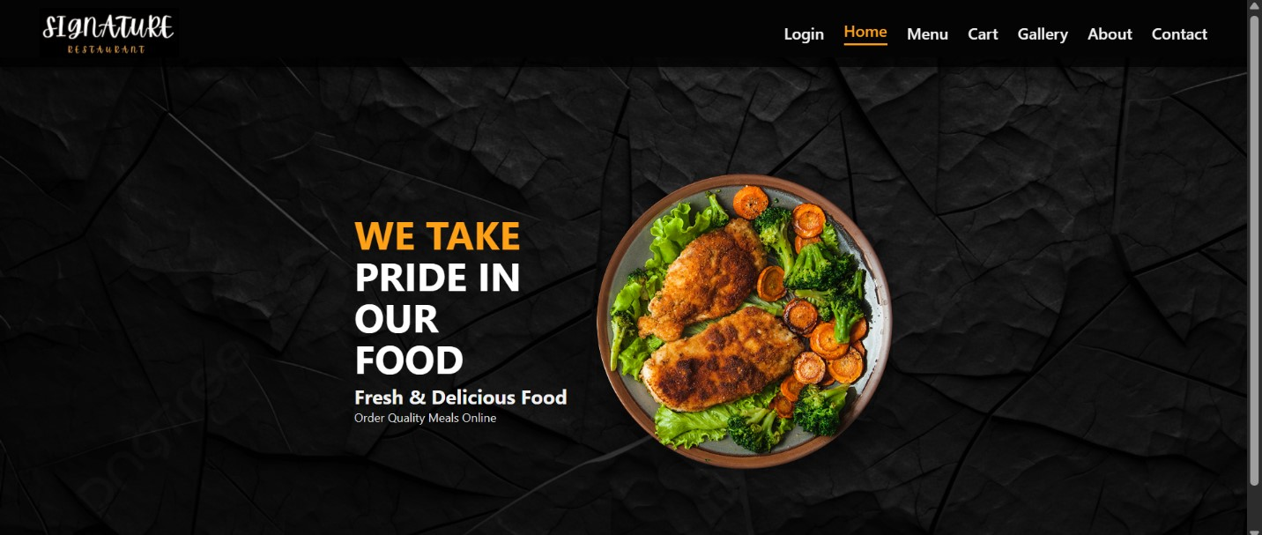
Site Structure
7 main pages with navigation bar providing best & user friendly experience
Home Page:
It will be the User’s first impression

Slide 7
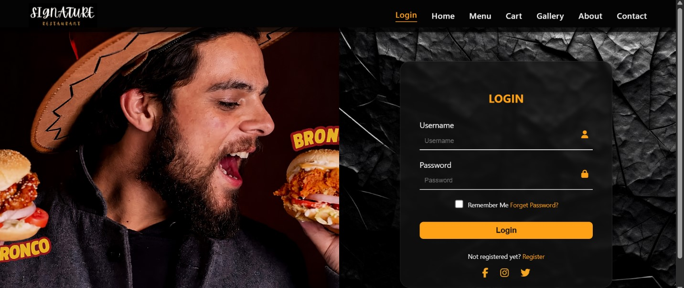
Site Structure
Login Page:
User Can place order after successful login

Slide 8
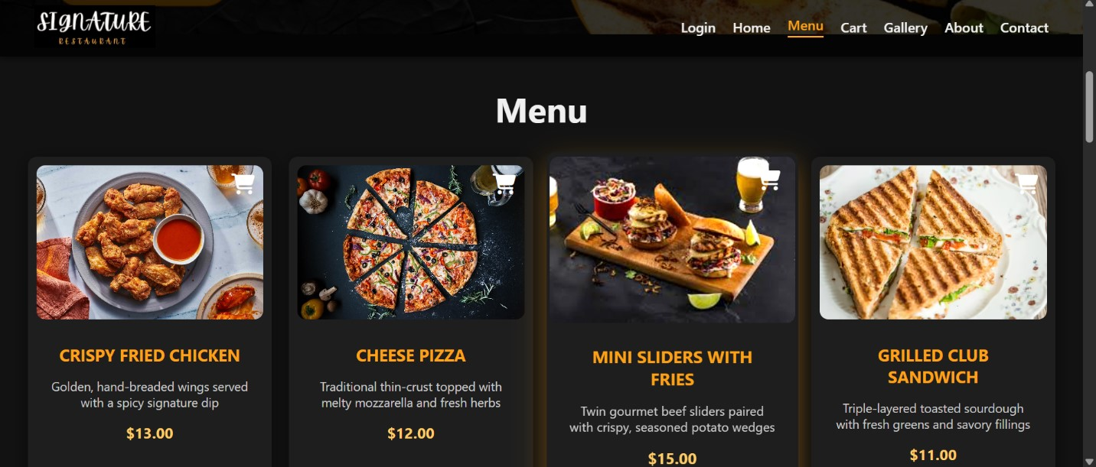
Site Structure
Menu Page:
User can see te menu items from this page

Slide 9
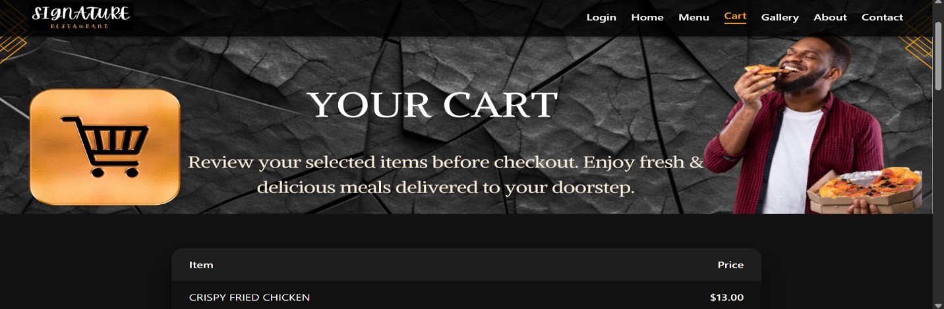
Site Structure
Cart Page:
This page is dedicated to place an order

Slide 10
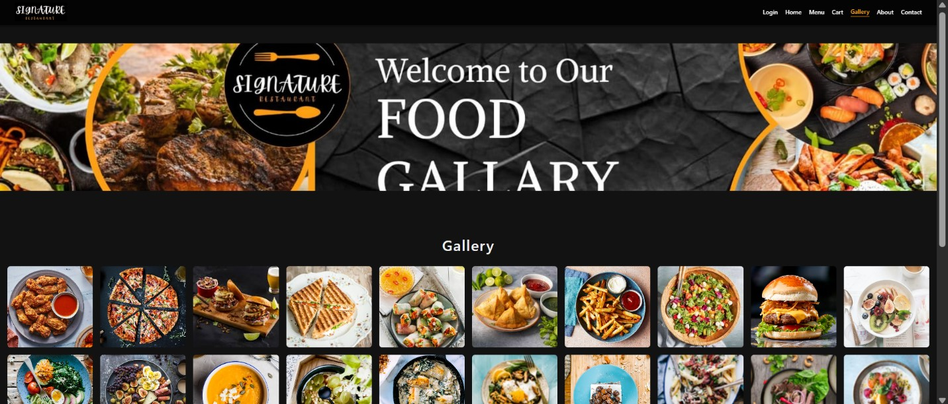
Site Structure
Gallary Page:
We have uploaded the pictures of our delicious food in this page

Slide 11
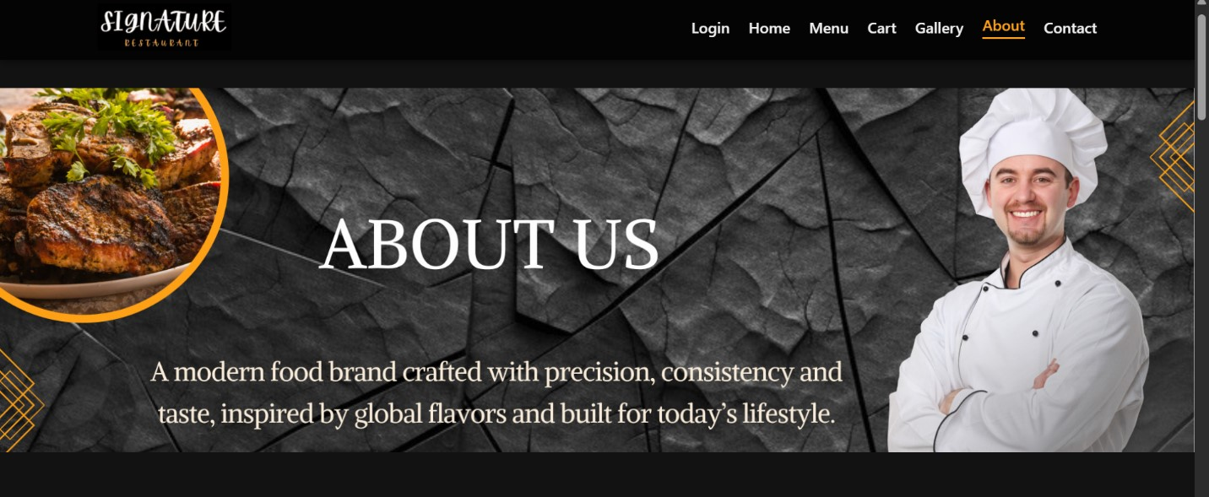
Site Structure
About Page:
This page is dedicated to describe the services & values of our restaurant

Slide 12
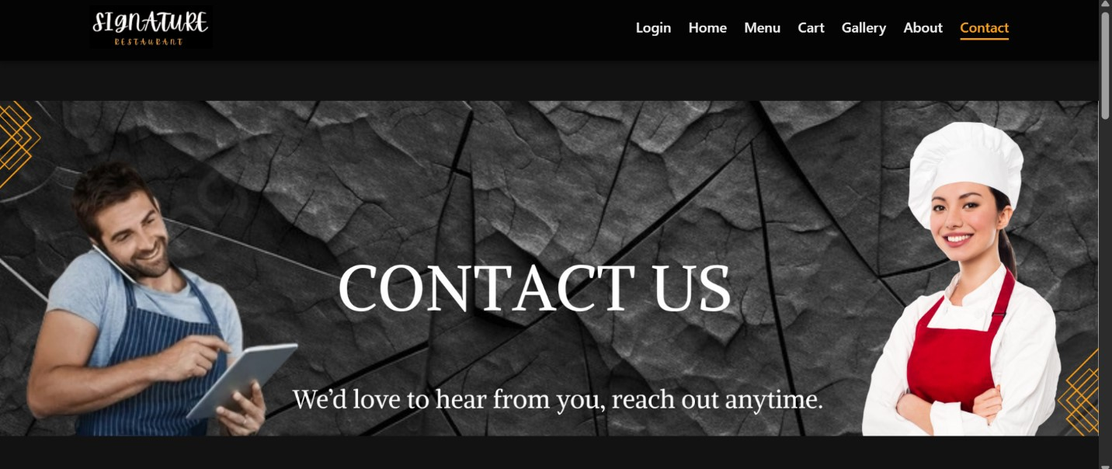
Site Structure
Contact Page:
From this page user can easily get our contact details.

Slide 13
Design Decisions
Simple clean and user friendly user interface
Readable fonts & consistent styling
Dark background and light readable text, Orange as attention color.
Focus on responsiveness & simplicity

Slide 14
Assets & Technology
HTML5 + CSS3
Images from Pexels, Unsplash.
Logo & Header made from Canva
Fictional Data (No database)
Menu Brochure was made from Canva
Video was also made using video editing tools like canva, filmora, spring.

Slide 15
Excel Key Data:
Product Profit:
This graph is showing the profit that we are earning from each item of our menu.
The most profitable item is Chocolate cake

Slide 16
Selling Prices of different Products:
This Chart is giving the information about the selling price of each item.

Slide 17
Publishing of website
We can run/publish the website by many ways:
Publishing the website by simply opening the index.htlm file in chrome or Microsoft edge
We can also publish the website using Github and creating the live URL
Live URL of our Website:
https://malimunir29.github.io/Group-08-Online-Restaurant/

Slide 18
Reflection & Improvements
What We Learned:
Creating website design
Responsive layouts
Interactive features & animation
Usage of Different Video editing tools like Canva, Filmora, Spring
Future Improvements:
Backend, database
Real time ordering

Slide 19
THANK YOU

